Slide 1


Sentiment Analysis
Broghan O’Connor

Slide 2



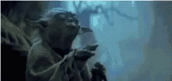


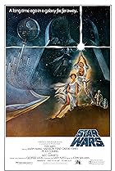

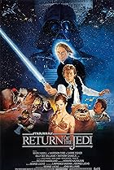


Slide 3
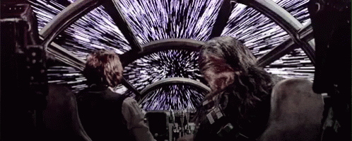



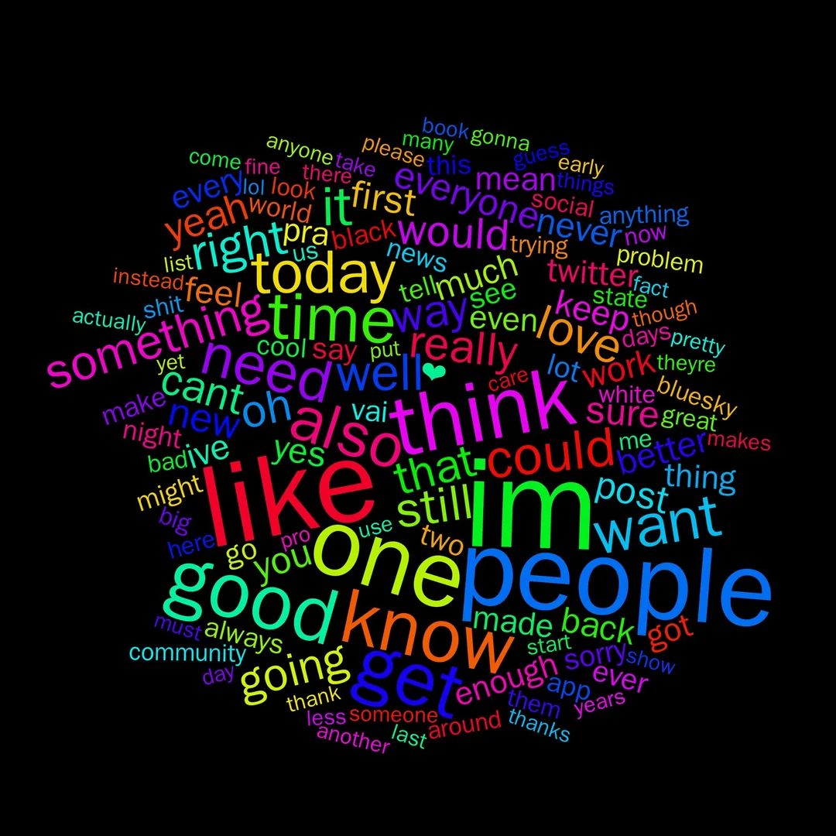
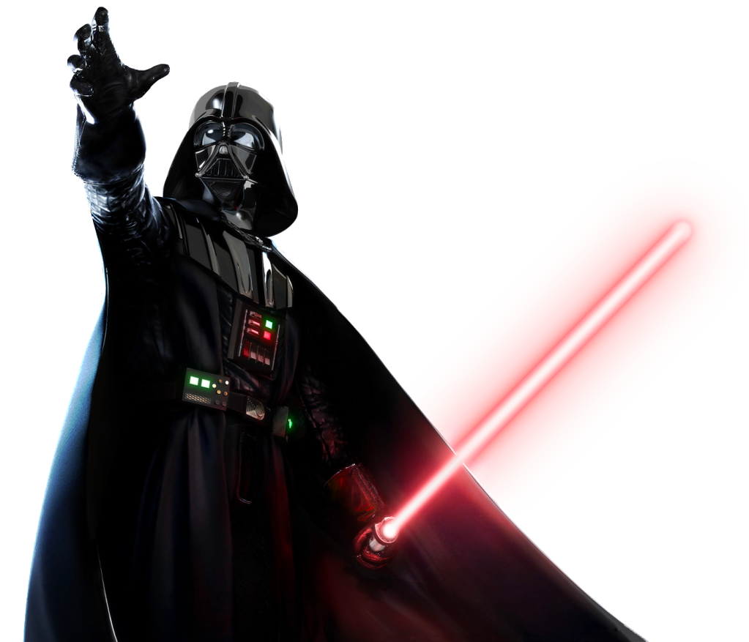

Process
Scraped
Sentiment Analysis
Topic Modeling

Slide 4

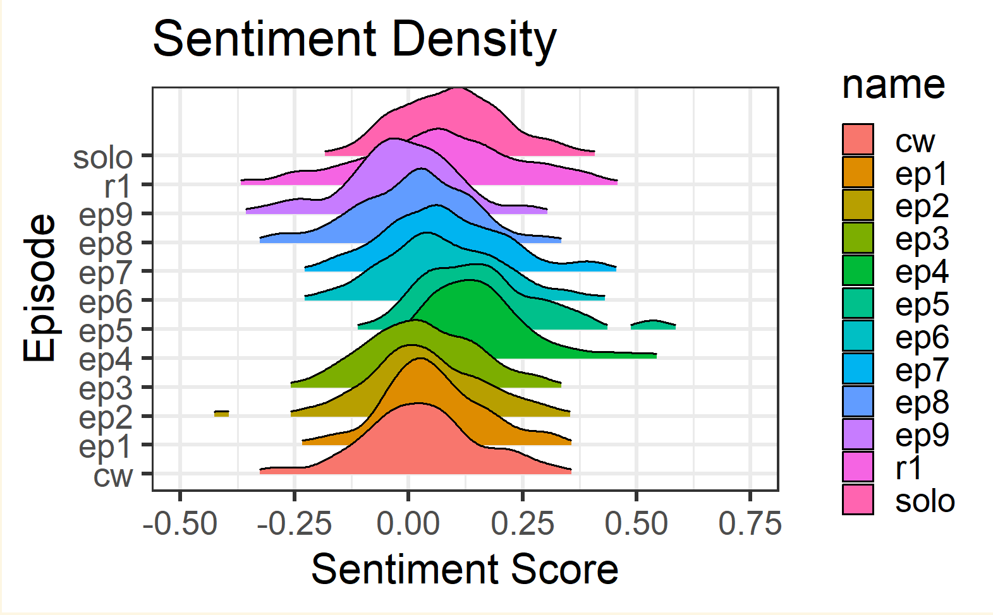

Slide 5
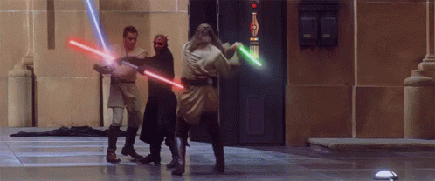
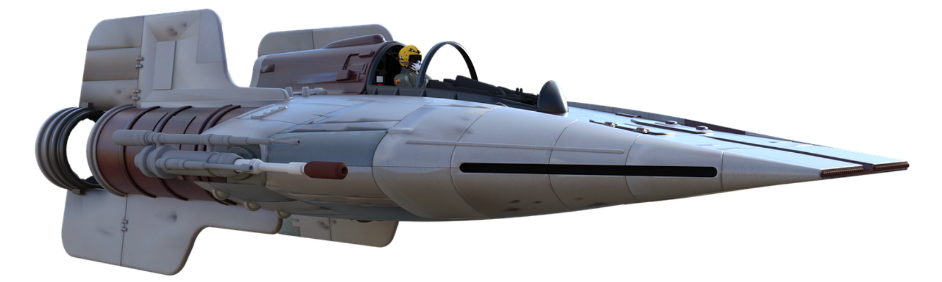
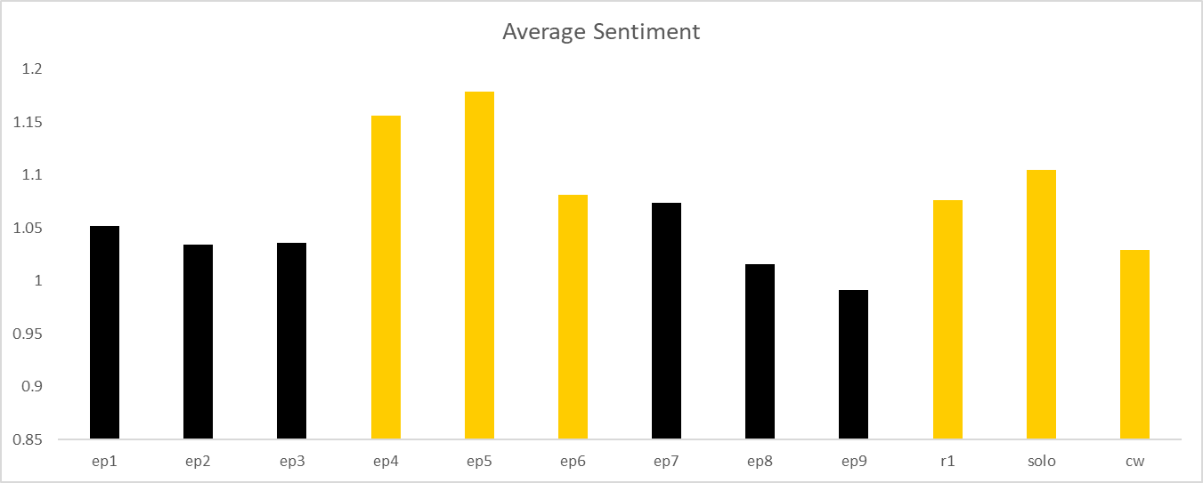

Slide 6

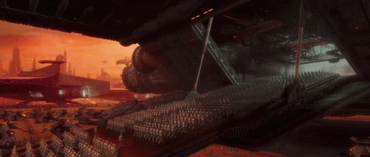
Sentiment
Episode 5 | Episode 5
Episode 7 | Episode 4
Episode 4 | Solo
Episode 8 | Episode 6
Rogue 1 | Rogue 1
Episode 6 | Episode 7
Episode 3 | Episode 1
Solo | Episode 3
Episode 2 | Episode 2
Episode 9 | Clone Wars
Episode 1 | Episode 8
Clone Wars | Episode 9

Slide 7

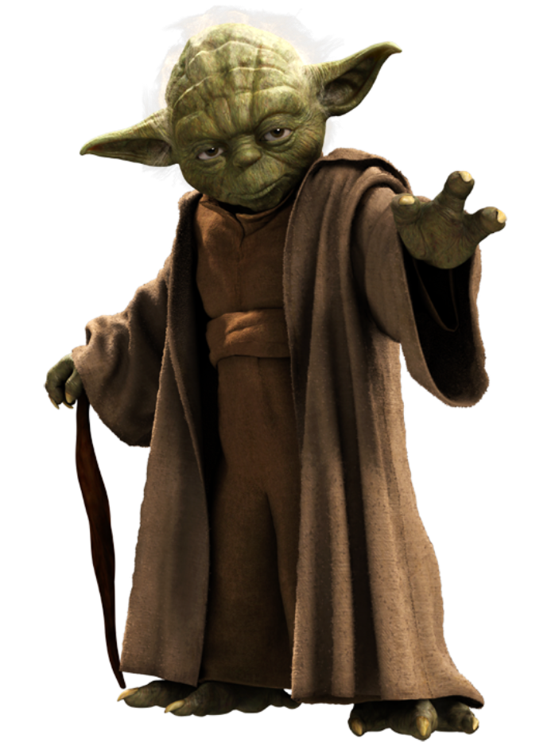
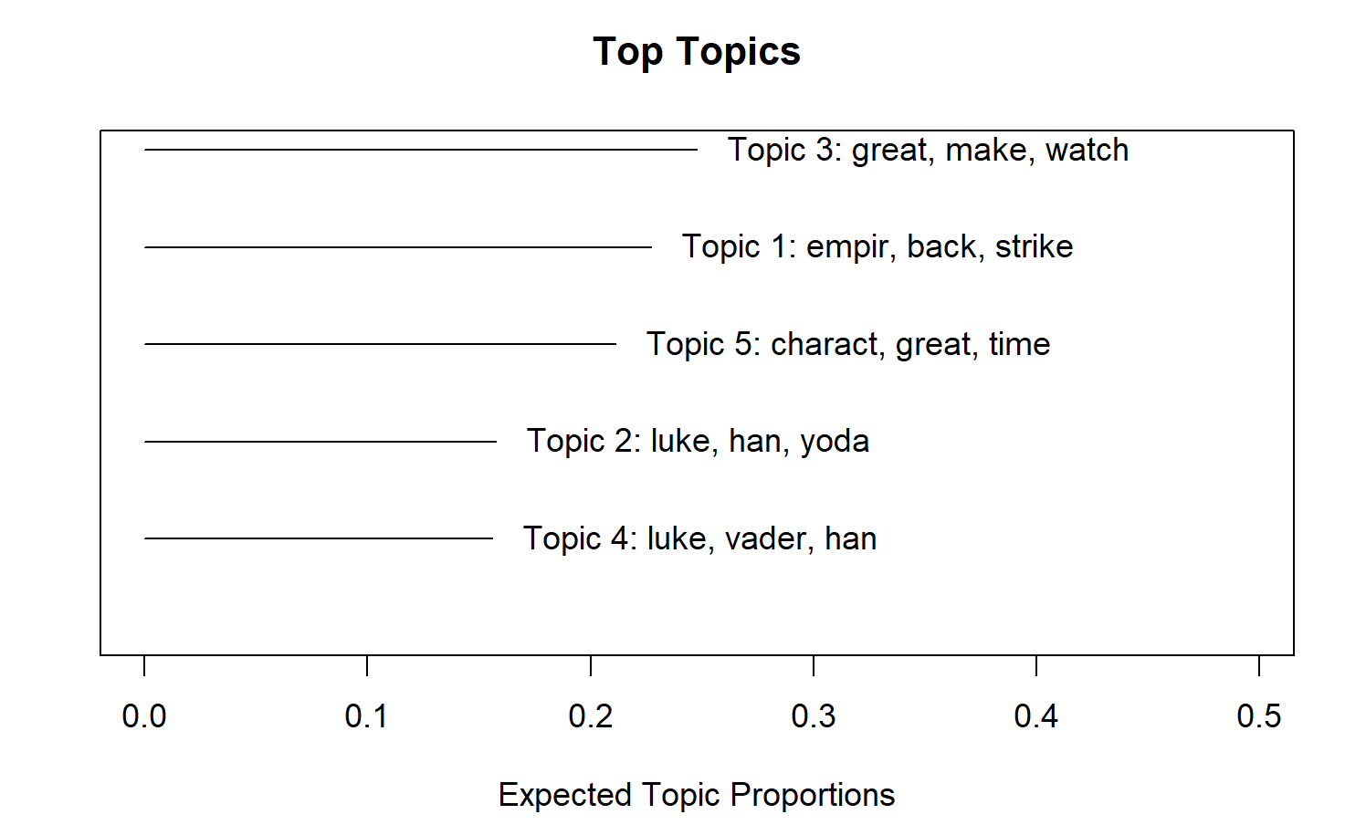

Slide 8

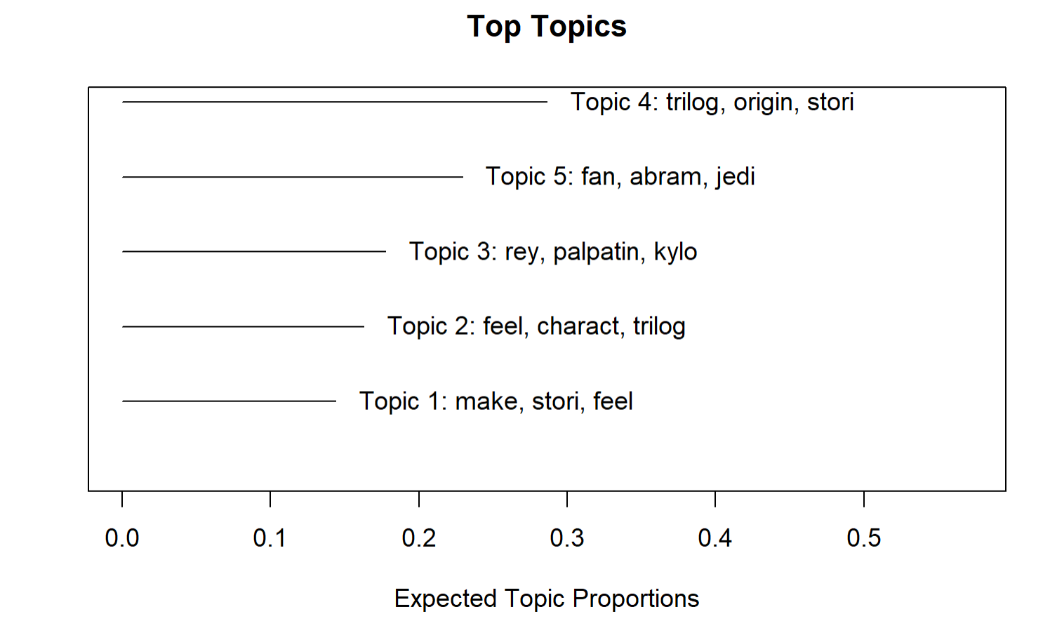
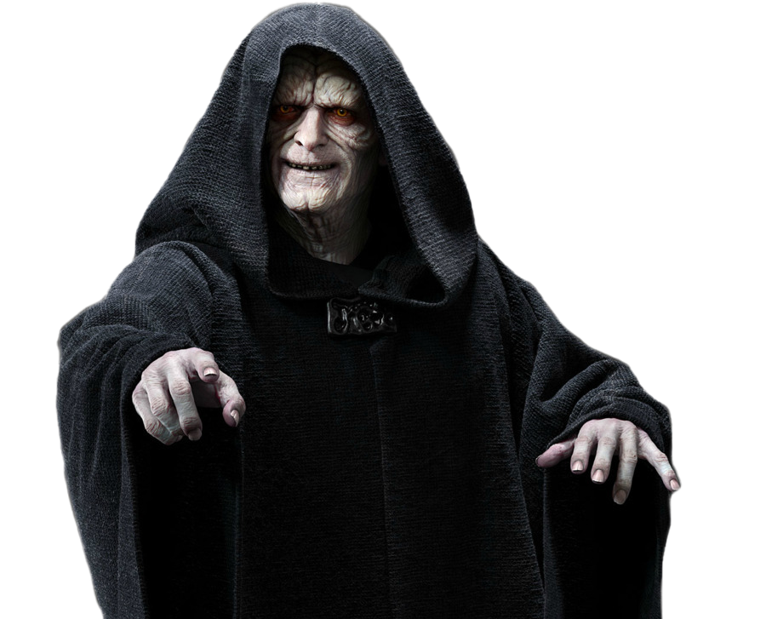

Slide 9
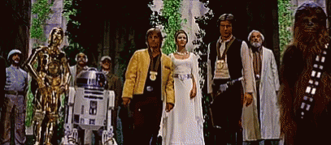
Thank You

